Slide 1
Texas Prescription ​
Monitoring Program ​201​
Texas Targeted Opioid Response

Slide 2
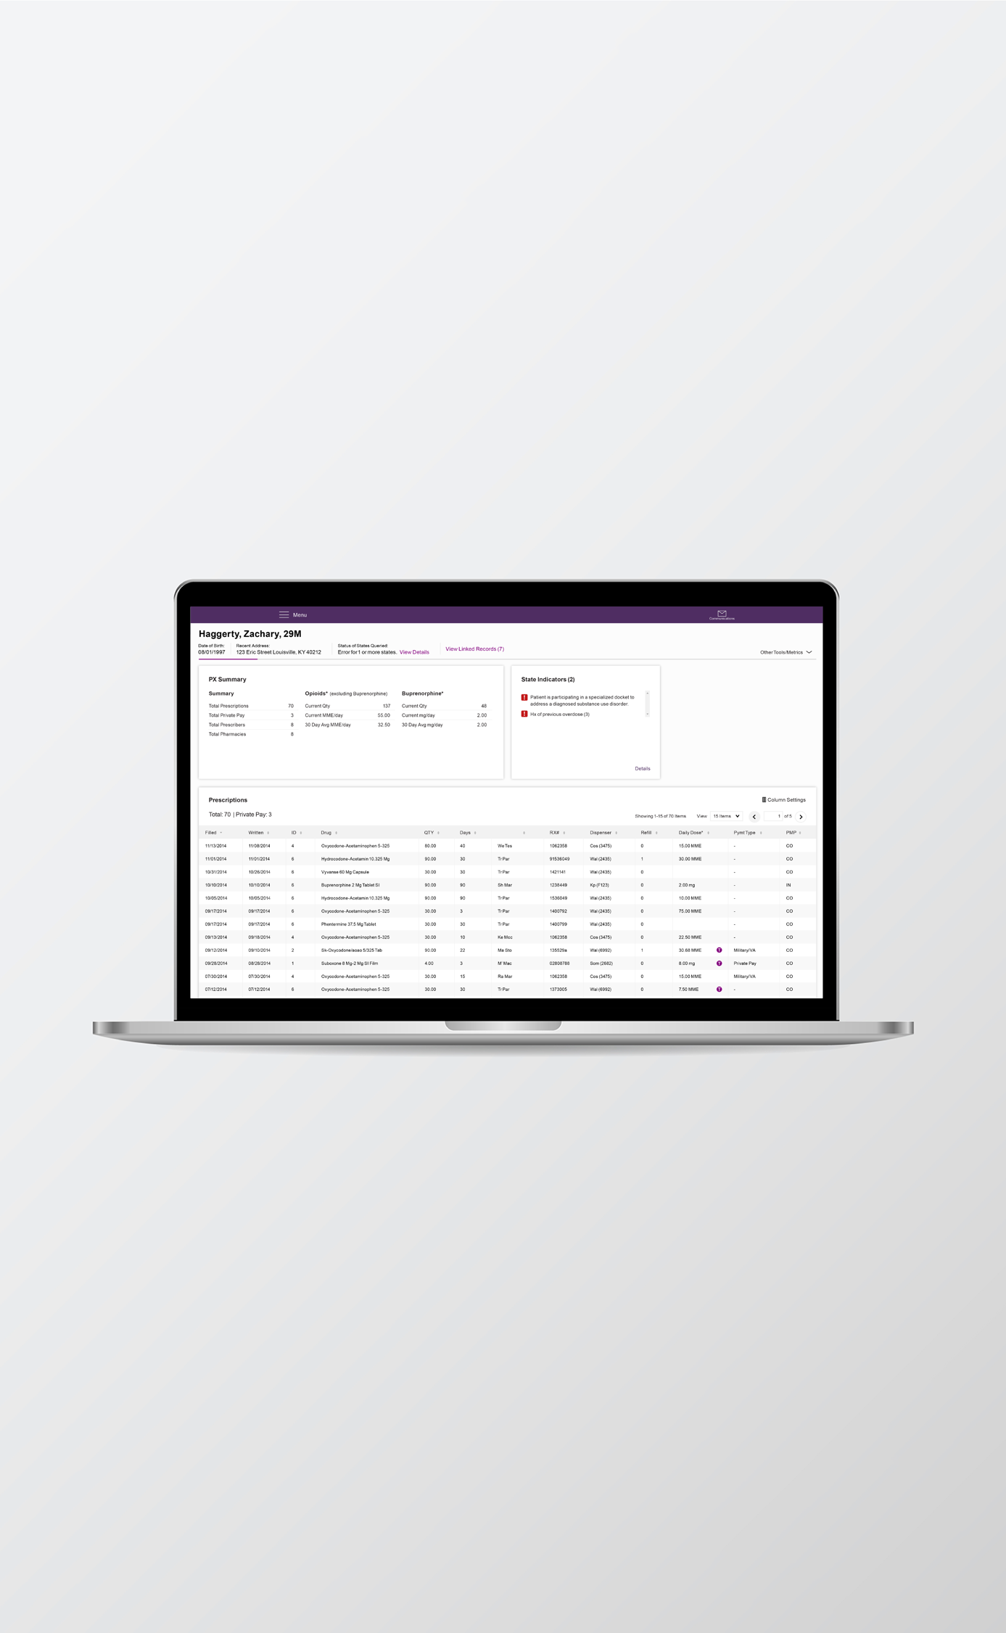
Identifying Patient
Risk Factors
PMP data may indicate:​
Overlapping prescriptions​
Obtaining prescriptions from several prescribers and/or pharmacies​
Dosages at or above 50 MME/day (per the CDC, increases the risk
of overdose by at least 2x the risk at <20 MME/day)​​
Remember: Concerns should trigger a discussion, not a decision​

Slide 3
Talking About Concerning PMP Results
These conversations can be challenging, but the words you use impact your patients' health.​​
Evidence-based health communication best practices:​
Use non-stigmatizing, person-first language​
Use motivational interviewing techniques​
Demonstrate active listening​
Practice cognitive empathy​

Slide 4
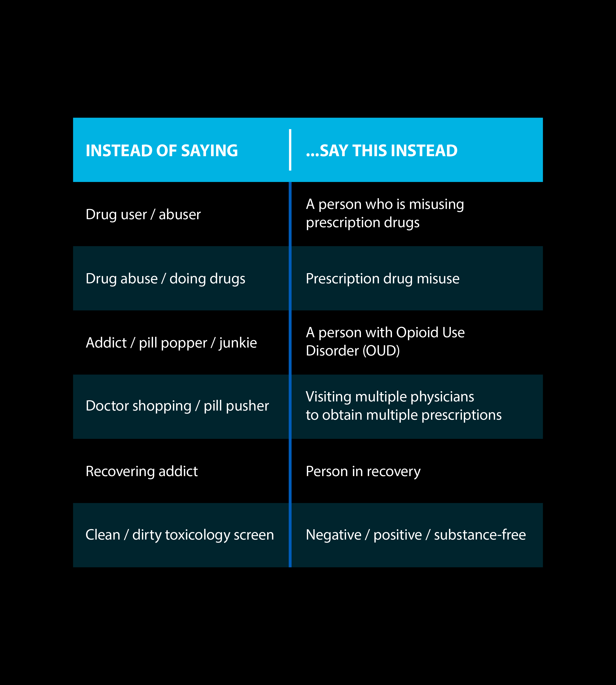
Non-Stigmatizing Language
Stigma: negative attitudes or discrimination against someone based on a distinguishing characteristic such as a health condition,
mental illness or disability​
Providers who see SUD as the patient’s own fault may unknowingly provide substandard care​
People with SUD internalize stigma, may feel shame and refuse to seek treatment​

Slide 5

Implicit Bias
Unconscious association, belief or attitude toward a social group​
May lead to attributing certain qualities or characteristics to all members of a particular group​
Can affect the way providers interact with patients​
Checking the PMP for every patient, every time helps to eliminate implicit bias, ensuring prescribing and dispensing decisions are informed by data.​

Slide 6

Person-First Language
Put the subject of your sentence before any words that describe them, putting the person before the condition​
Maintains the integrity of individuals as whole human beings,
rather than essentializing a person using a single trait​
Examples​
  "She's diabetic” "A person with Type 2 diabetes"​
  "An AIDS victim” "A person living with HIV/AIDS"​
  "Drug addict” "Person with a substance use disorder"​

Slide 7
Communication
Best Practices
Use motivational interviewing techniques ​
  Develop rapport​
  Ask open-ended questions​
  Encourage the patient to reflect on the positive effects of behavior change​
Demonstrate active listening ​
  Nonverbal body language: eye contact, nodding, sitting at eye-level​
  Ask follow-up questions ​
Teach back method​
  Ask the patient to recap your conversation in their own words​
  Creates an opportunity to establish understanding and agreement​
  Remember: it's about including the patient, not testing them​

Slide 8

Practicing Empathy
Affective Empathy​
  The ability to share the feelings of another person​
  Unrealistic to relate to every patient, leads to provider burnout​
Cognitive Empathy​
  The ability to understand how a patient feels and what they might be thinking​
  Recognize and validate their feelings as real and powerful, even if you can't relate or don't agree​
  Saying the caring thing, even if you can't personally relate

Slide 9
Next Steps
& Harm Reduction
Consider collaborating with the patient to taper opioids to a safer dosage​
Consider offering naloxone​
Facilitate a referral to specialist treatment services​
Outreach Screening Assessment & Referral services (O.S.A.R.)​
Medication Assisted Treatment (M.A.T.)​
Schedule a follow up appointment

Slide 10
Additional Resources​
Txpmp.org/resources​
PMP Toolkit​
Txopioidresponse.org​
Implicit Bias​
CDC: Prescription Drug Monitoring Programs (PDMPs)​
Harvard Health: Are Prescription Monitoring Programs Helpful or Harmful?​
Words Matter (National Institute on Drug Abuse)​
OSAR / Texas Health and Human Services Commission (HHSC)​
Patient Screening Tools​

Slide 11

For additional resources,
visit txpmp.org.

